Slide 1
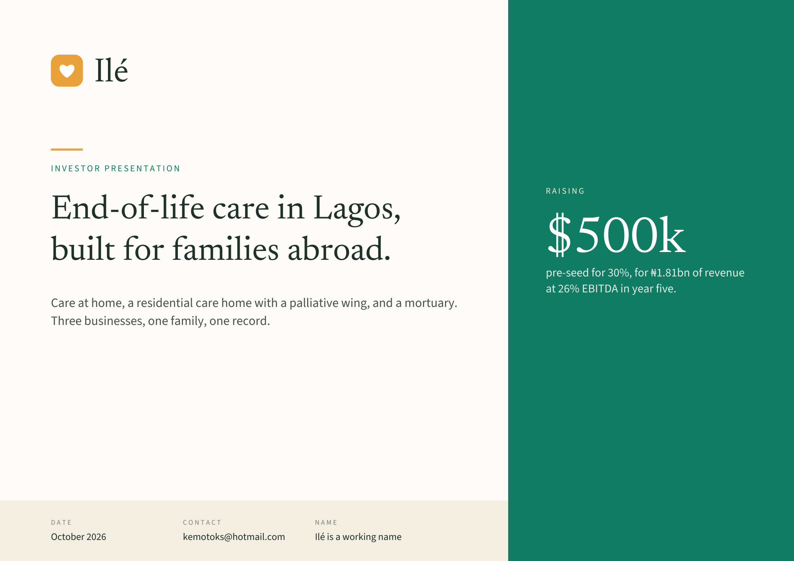
Notes:
Ilé
INVESTOR PRESENTATION
RAISING
End-of-life care in Lagos,
built for families abroad. $500k
pre-seed for 30%, for ₦1.81bn of revenue
at 26% EBITDA in year five.
Care at home, a residential care home with a palliative wing, and a mortuary.
Three businesses, one family, one record.
DATE CONTACT NAME
October 2026 kemotoks@hotmail.com Ilé is a working name

Slide 2
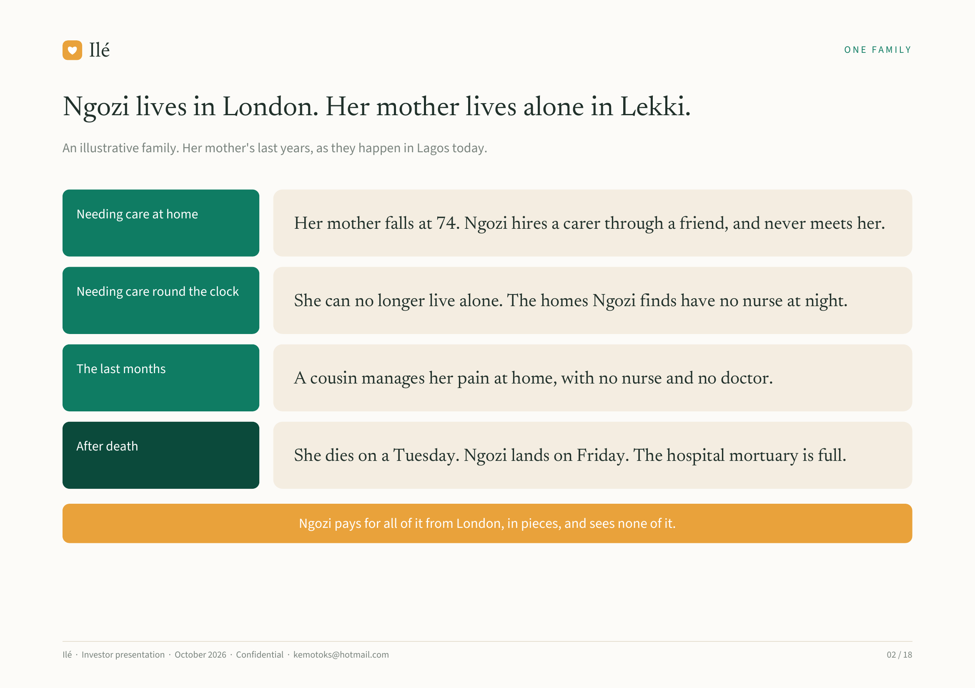
Notes:
Ilé ONE FAMILY
Ngozi lives in London. Her mother lives alone in Lekki.
An illustrative family. Her mother's last years, as they happen in Lagos today.
Needing care at home
Her mother falls at 74. Ngozi hires a carer through a friend, and never meets her.
Needing care round the clock
She can no longer live alone. The homes Ngozi finds have no nurse at night.
The last months
A cousin manages her pain at home, with no nurse and no doctor.
After death
She dies on a Tuesday. Ngozi lands on Friday. The hospital mortuary is full.
Ngozi pays for all of it from London, in pieces, and sees none of it.
Ilé · Investor presentation · October 2026 · Confidential · kemotoks@hotmail.com 02 / 18

Slide 3
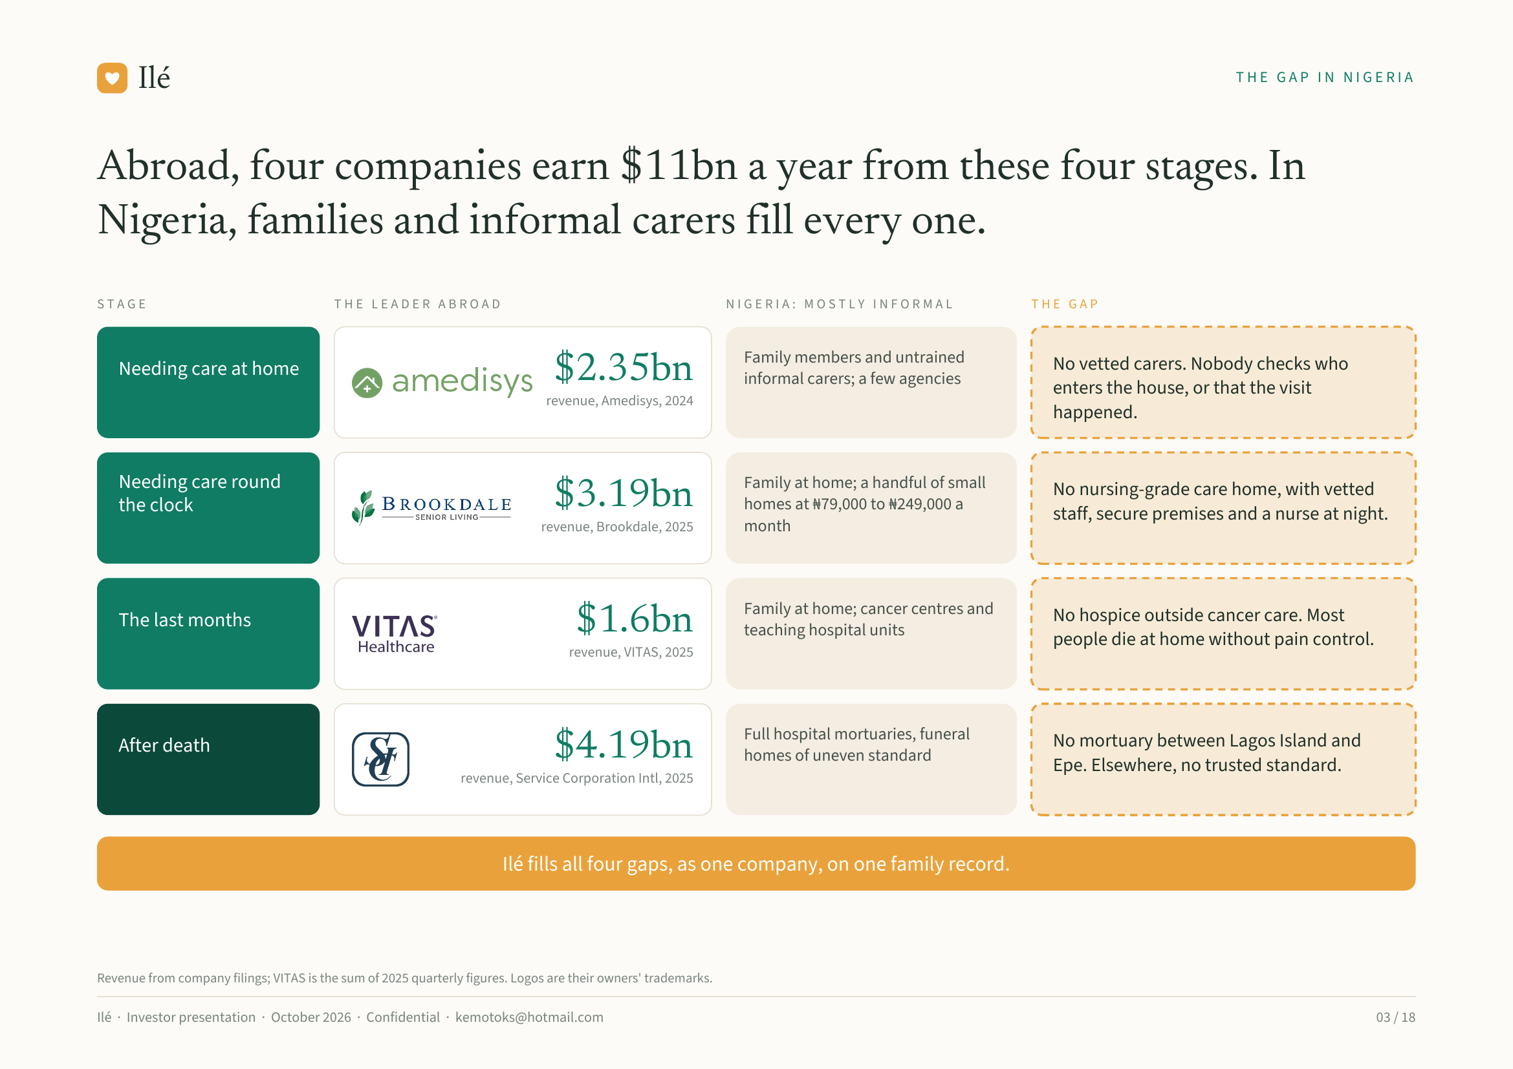
Notes:
Ilé THE GAP IN NIGERIA
Abroad, four companies earn $11bn a year from these four stages. In
Nigeria, families and informal carers fill every one.
STAGE THE LEADER ABROAD NIGERIA: MOSTLY INFORMAL THE GAP
Family members and untrained No vetted carers. Nobody checks who
Needing care at home $2.35bn informal carers; a few agencies
enters the house, or that the visit
revenue, Amedisys, 2024
happened.
Needing care round Family at home; a handful of small No nursing-grade care home, with vetted
the clock $3.19bn homes at ₦79,000 to ₦249,000 a
staff, secure premises and a nurse at night.
revenue, Brookdale, 2025 month
Family at home; cancer centres and No hospice outside cancer care. Most
The last months $1.6bn teaching hospital units
people die at home without pain control.
revenue, VITAS, 2025
Full hospital mortuaries, funeral No mortuary between Lagos Island and
After death $4.19bn homes of uneven standard
Epe. Elsewhere, no trusted standard.
revenue, Service Corporation Intl, 2025
Ilé fills all four gaps, as one company, on one family record.
Revenue from company filings; VITAS is the sum of 2025 quarterly figures. Logos are their owners' trademarks.
Ilé · Investor presentation · October 2026 · Confidential · kemotoks@hotmail.com 03 / 18

Slide 4
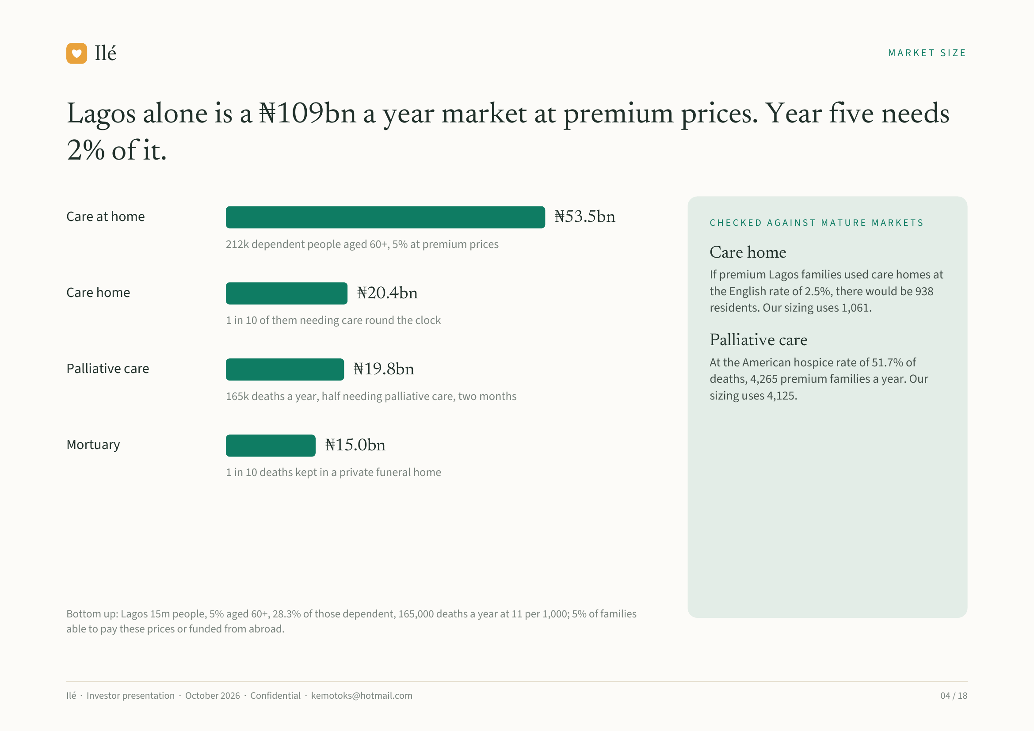
Notes:
Ilé MARKET SIZE
Lagos alone is a ₦109bn a year market at premium prices. Year five needs
2% of it.
Care at home ₦53.5bn CHECKED AGAINST MATURE MARKETS
212k dependent people aged 60+, 5% at premium prices
Care home
If premium Lagos families used care homes at
Care home ₦20.4bn the English rate of 2.5%, there would be 938
residents. Our sizing uses 1,061.
1 in 10 of them needing care round the clock
Palliative care
At the American hospice rate of 51.7% of
Palliative care ₦19.8bn deaths, 4,265 premium families a year. Our
165k deaths a year, half needing palliative care, two months sizing uses 4,125.
Mortuary ₦15.0bn
1 in 10 deaths kept in a private funeral home
Bottom up: Lagos 15m people, 5% aged 60+, 28.3% of those dependent, 165,000 deaths a year at 11 per 1,000; 5% of families
able to pay these prices or funded from abroad.
Ilé · Investor presentation · October 2026 · Confidential · kemotoks@hotmail.com 04 / 18

Slide 5
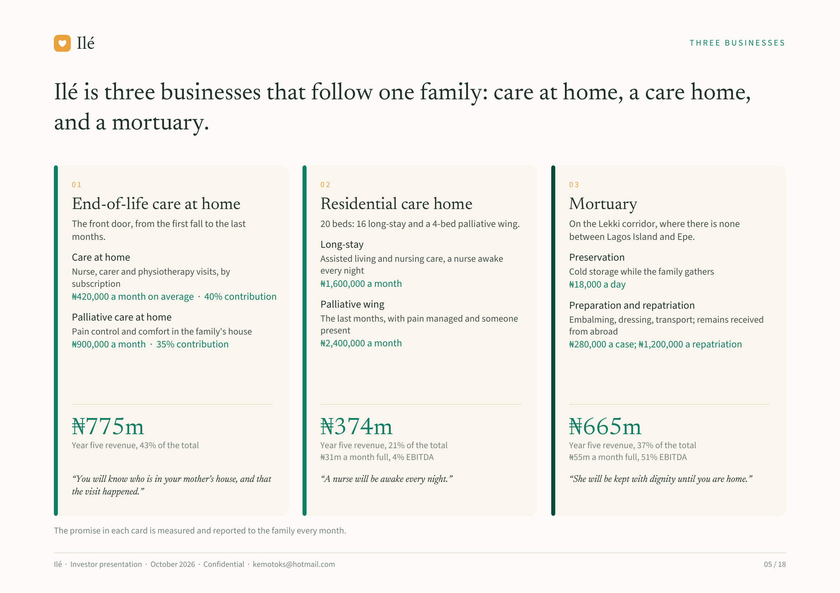
Notes:
Ilé THREE BUSINESSES
Ilé is three businesses that follow one family: care at home, a care home,
and a mortuary.
01 02 03
End-of-life care at home Residential care home Mortuary
The front door, from the first fall to the last 20 beds: 16 long-stay and a 4-bed palliative wing. On the Lekki corridor, where there is none
months. between Lagos Island and Epe.
Long-stay
Care at home Assisted living and nursing care, a nurse awake Preservation
Nurse, carer and physiotherapy visits, by every night Cold storage while the family gathers
subscription ₦1,600,000 a month ₦18,000 a day
₦420,000 a month on average · 40% contribution
Palliative wing Preparation and repatriation
Palliative care at home The last months, with pain managed and someone Embalming, dressing, transport; remains received
Pain control and comfort in the family's house present from abroad
₦900,000 a month · 35% contribution ₦2,400,000 a month ₦280,000 a case; ₦1,200,000 a repatriation
₦775m ₦374m ₦665m
Year five revenue, 43% of the total Year five revenue, 21% of the total Year five revenue, 37% of the total
₦31m a month full, 4% EBITDA ₦55m a month full, 51% EBITDA
“You will know who is in your mother's house, and that “A nurse will be awake every night.” “She will be kept with dignity until you are home.”
the visit happened.”
The promise in each card is measured and reported to the family every month.
Ilé · Investor presentation · October 2026 · Confidential · kemotoks@hotmail.com 05 / 18

Slide 6
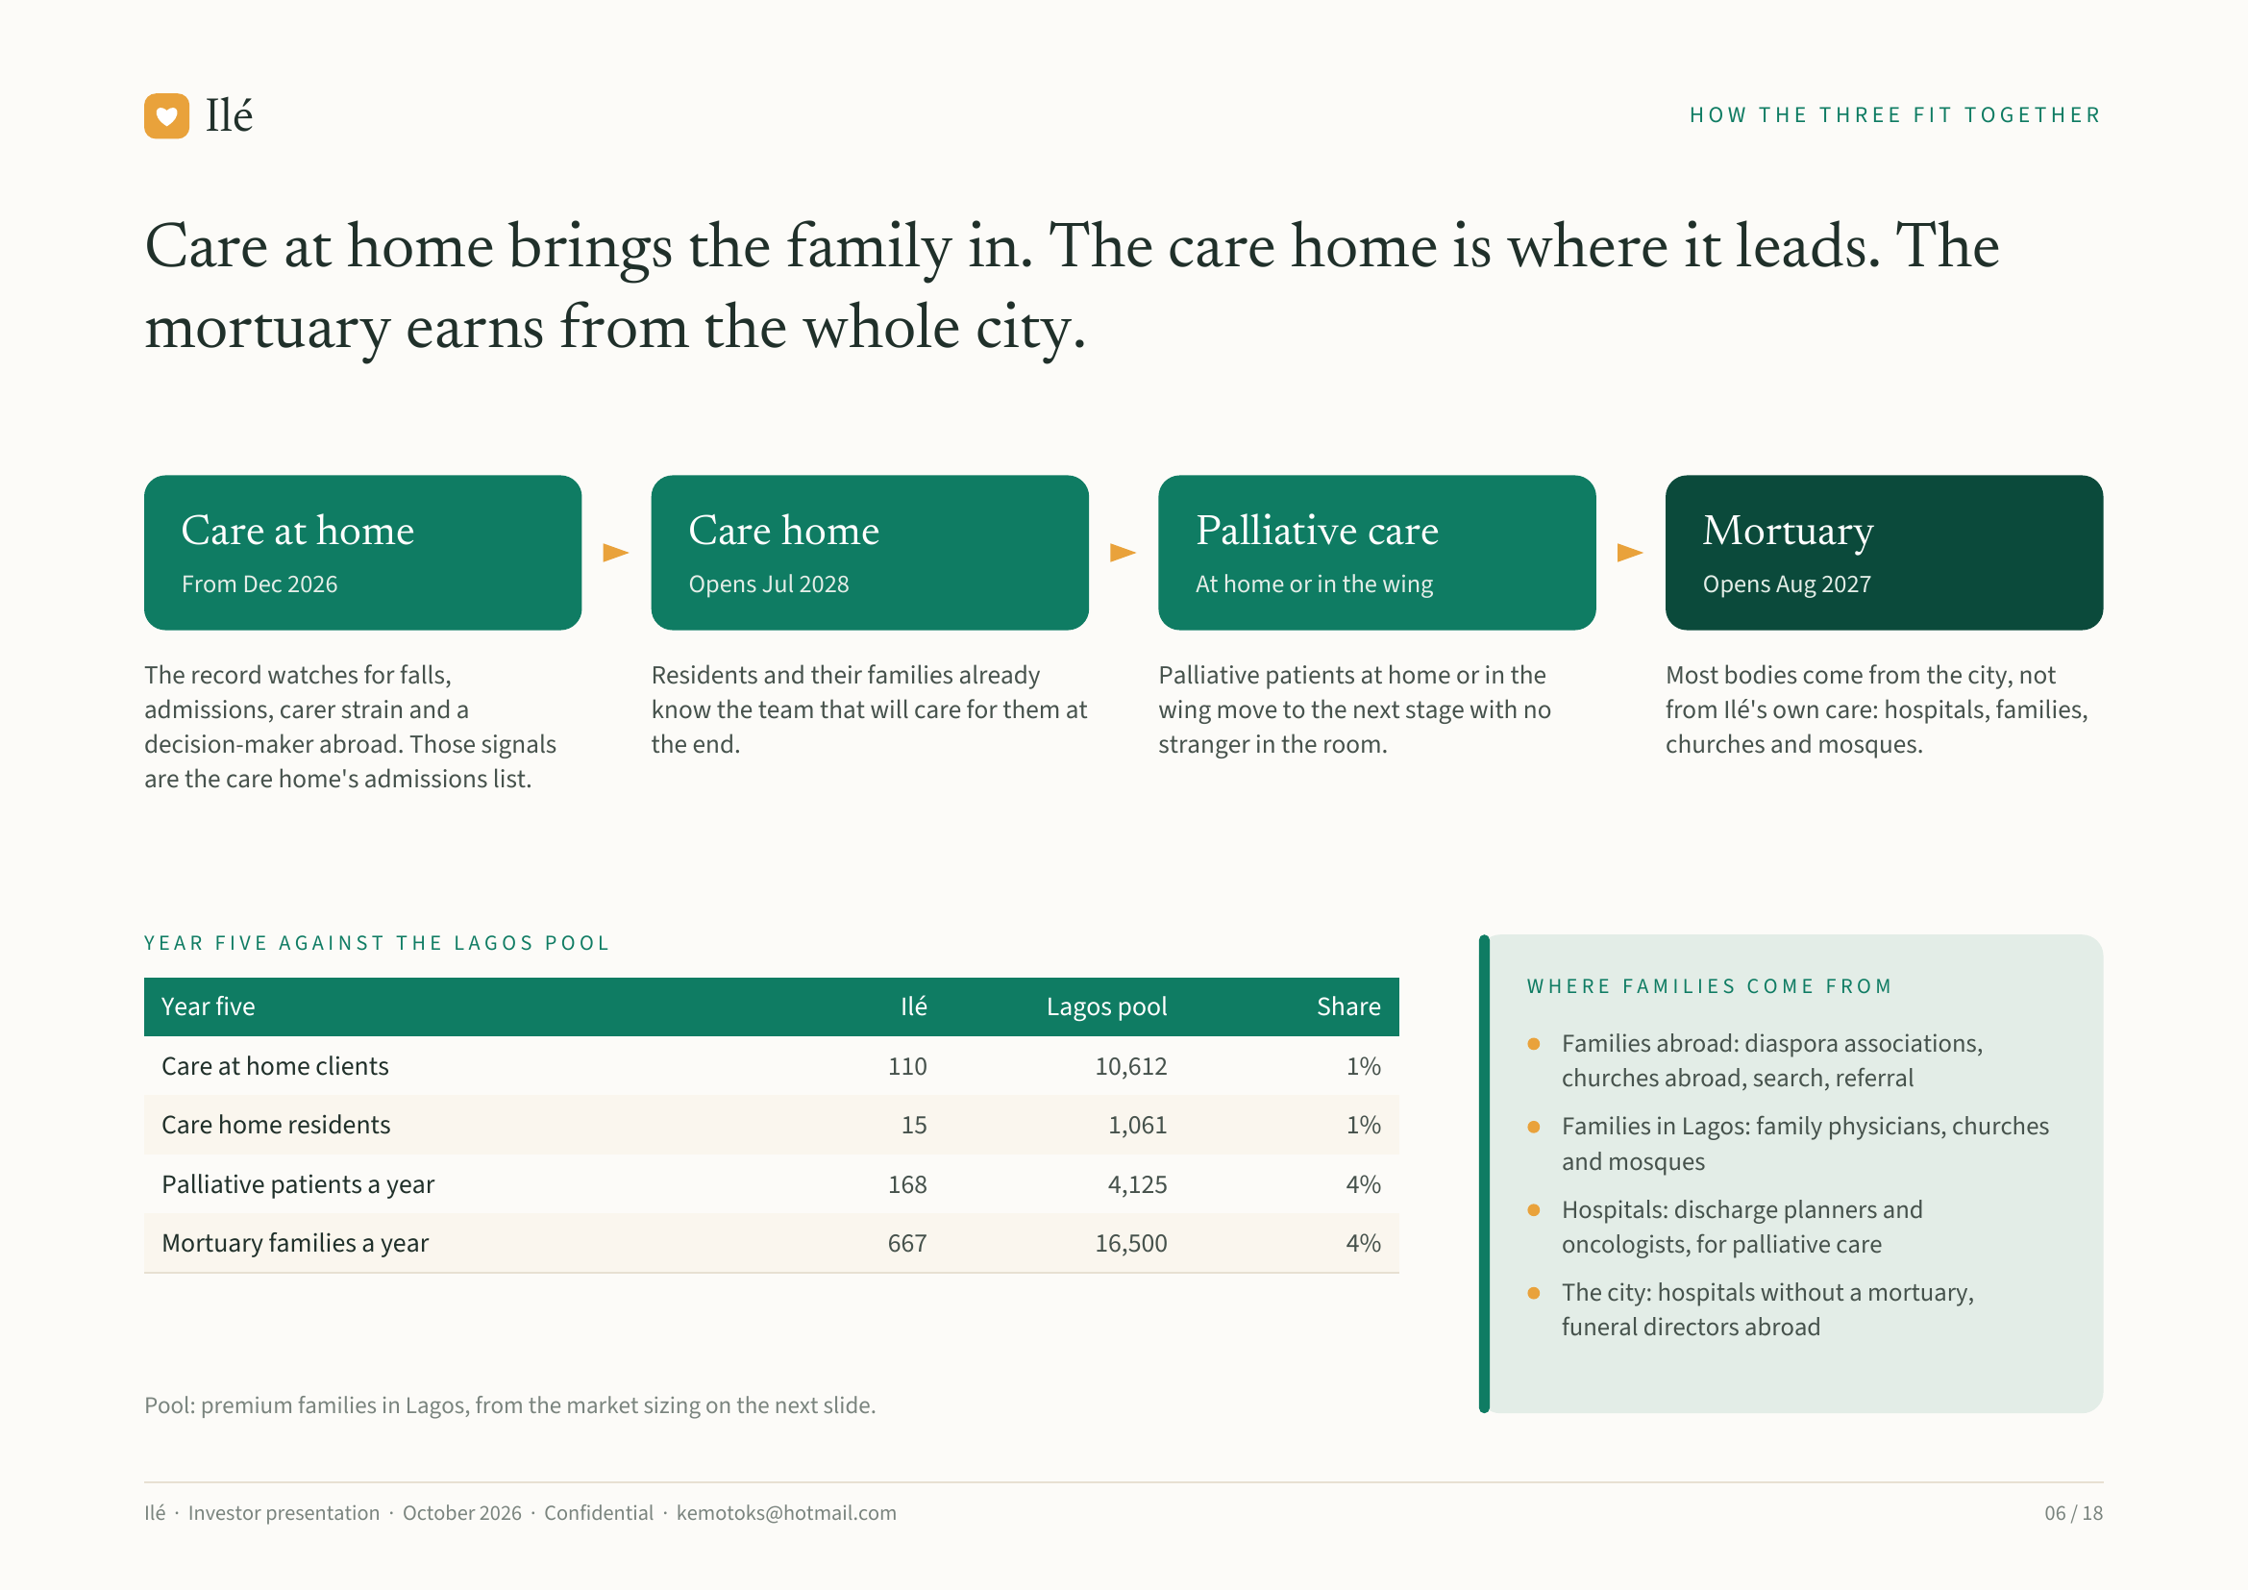
Notes:
Ilé HOW THE THREE FIT TOGETHER
Care at home brings the family in. The care home is where it leads. The
mortuary earns from the whole city.
Care at home Care home Palliative care Mortuary
From Dec 2026 Opens Jul 2028 At home or in the wing Opens Aug 2027
The record watches for falls, Residents and their families already Palliative patients at home or in the Most bodies come from the city, not
admissions, carer strain and a know the team that will care for them at wing move to the next stage with no from Ilé's own care: hospitals, families,
decision-maker abroad. Those signals the end. stranger in the room. churches and mosques.
are the care home's admissions list.
YEAR FIVE AGAINST THE LAGOS POOL
WHERE FAMILIES COME FROM
Year five Ilé Lagos pool Share
Families abroad: diaspora associations,
Care at home clients 110 10,612 1% churches abroad, search, referral
Care home residents 15 1,061 1% Families in Lagos: family physicians, churches
and mosques
Palliative patients a year 168 4,125 4%
Hospitals: discharge planners and
Mortuary families a year 667 16,500 4% oncologists, for palliative care
The city: hospitals without a mortuary,
funeral directors abroad
Pool: premium families in Lagos, from the market sizing on the next slide.
Ilé · Investor presentation · October 2026 · Confidential · kemotoks@hotmail.com 06 / 18

Slide 7
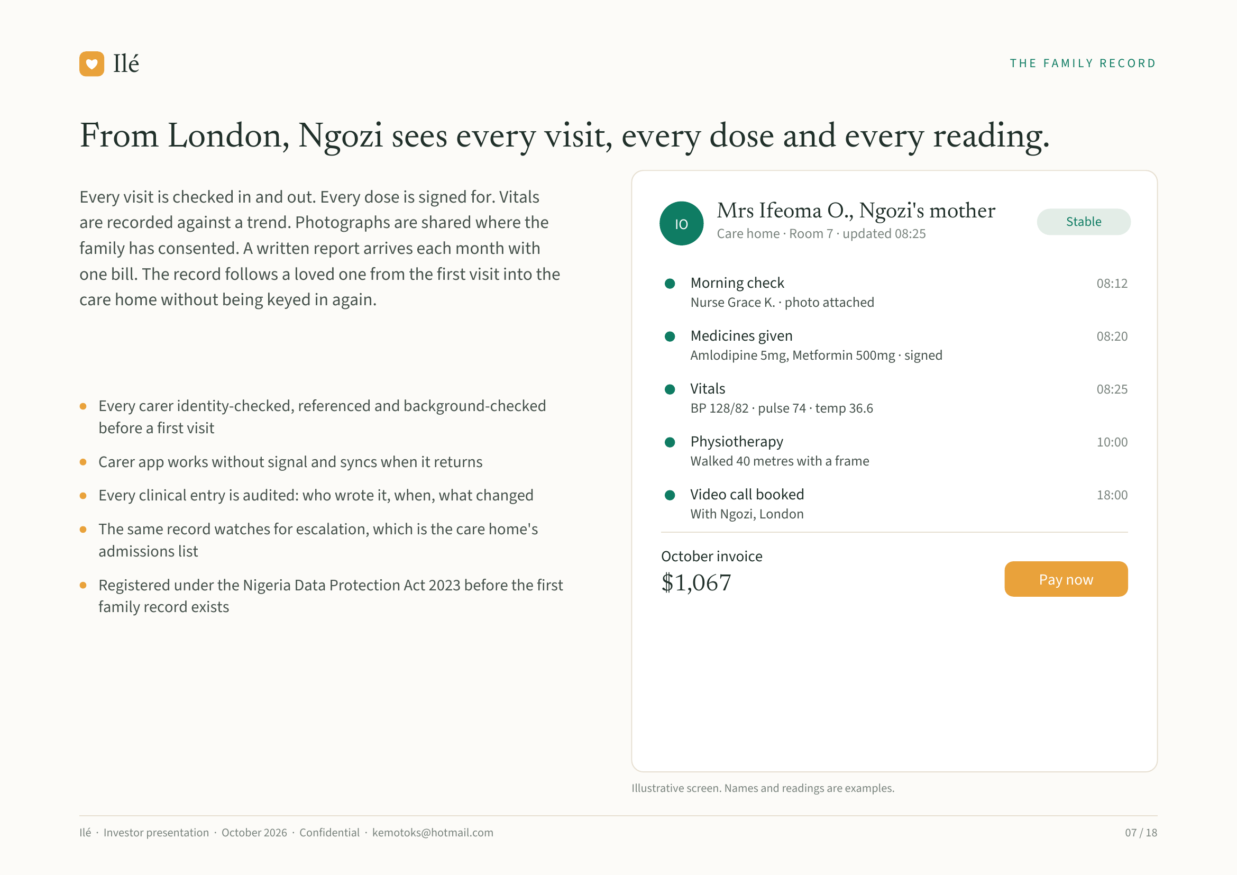
Notes:
Ilé THE FAMILY RECORD
From London, Ngozi sees every visit, every dose and every reading.
Every visit is checked in and out. Every dose is signed for. Vitals
Mrs Ifeoma O., Ngozi's mother
are recorded against a trend. Photographs are shared where the IO Stable
Care home · Room 7 · updated 08:25
family has consented. A written report arrives each month with
one bill. The record follows a loved one from the first visit into the Morning check 08:12
care home without being keyed in again. Nurse Grace K. · photo attached
Medicines given 08:20
Amlodipine 5mg, Metformin 500mg · signed
Vitals 08:25
Every carer identity-checked, referenced and background-checked BP 128/82 · pulse 74 · temp 36.6
before a first visit
Physiotherapy 10:00
Carer app works without signal and syncs when it returns Walked 40 metres with a frame
Every clinical entry is audited: who wrote it, when, what changed Video call booked 18:00
With Ngozi, London
The same record watches for escalation, which is the care home's
admissions list October invoice
Registered under the Nigeria Data Protection Act 2023 before the first $1,067 Pay now
family record exists
Illustrative screen. Names and readings are examples.
Ilé · Investor presentation · October 2026 · Confidential · kemotoks@hotmail.com 07 / 18

Slide 8
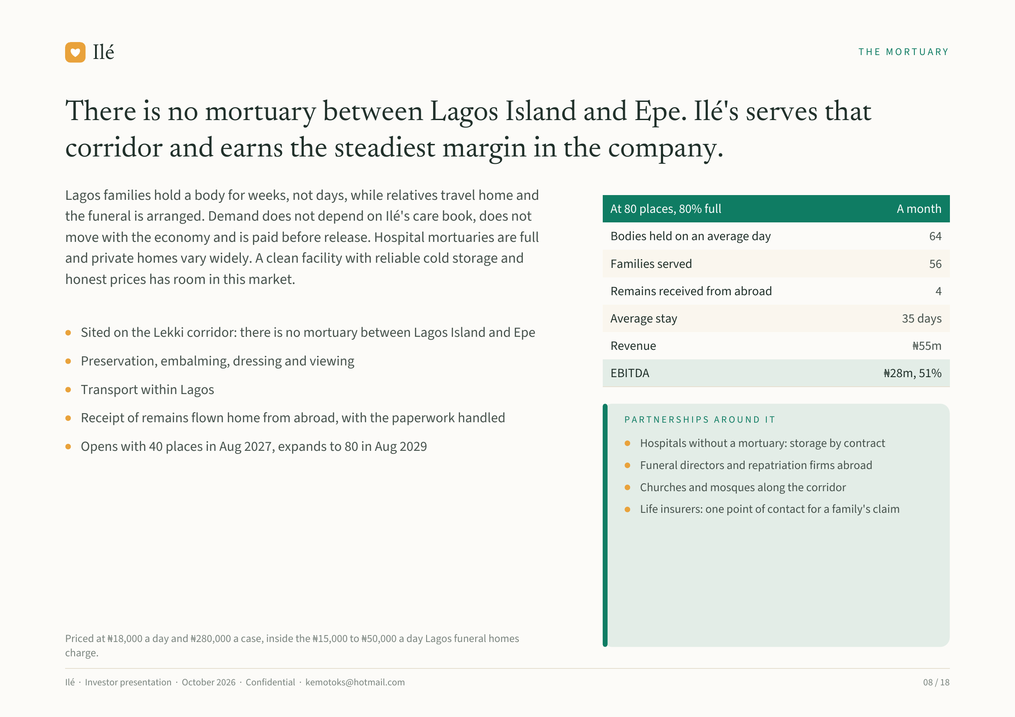
Notes:
Ilé THE MORTUARY
There is no mortuary between Lagos Island and Epe. Ilé's serves that
corridor and earns the steadiest margin in the company.
Lagos families hold a body for weeks, not days, while relatives travel home and
At 80 places, 80% full A month
the funeral is arranged. Demand does not depend on Ilé's care book, does not
move with the economy and is paid before release. Hospital mortuaries are full Bodies held on an average day 64
and private homes vary widely. A clean facility with reliable cold storage and Families served 56
honest prices has room in this market.
Remains received from abroad 4
Average stay 35 days
Sited on the Lekki corridor: there is no mortuary between Lagos Island and Epe
Revenue ₦55m
Preservation, embalming, dressing and viewing
EBITDA ₦28m, 51%
Transport within Lagos
Receipt of remains flown home from abroad, with the paperwork handled PARTNERSHIPS AROUND IT
Opens with 40 places in Aug 2027, expands to 80 in Aug 2029 Hospitals without a mortuary: storage by contract
Funeral directors and repatriation firms abroad
Churches and mosques along the corridor
Life insurers: one point of contact for a family's claim
Priced at ₦18,000 a day and ₦280,000 a case, inside the ₦15,000 to ₦50,000 a day Lagos funeral homes
charge.
Ilé · Investor presentation · October 2026 · Confidential · kemotoks@hotmail.com 08 / 18

Slide 9
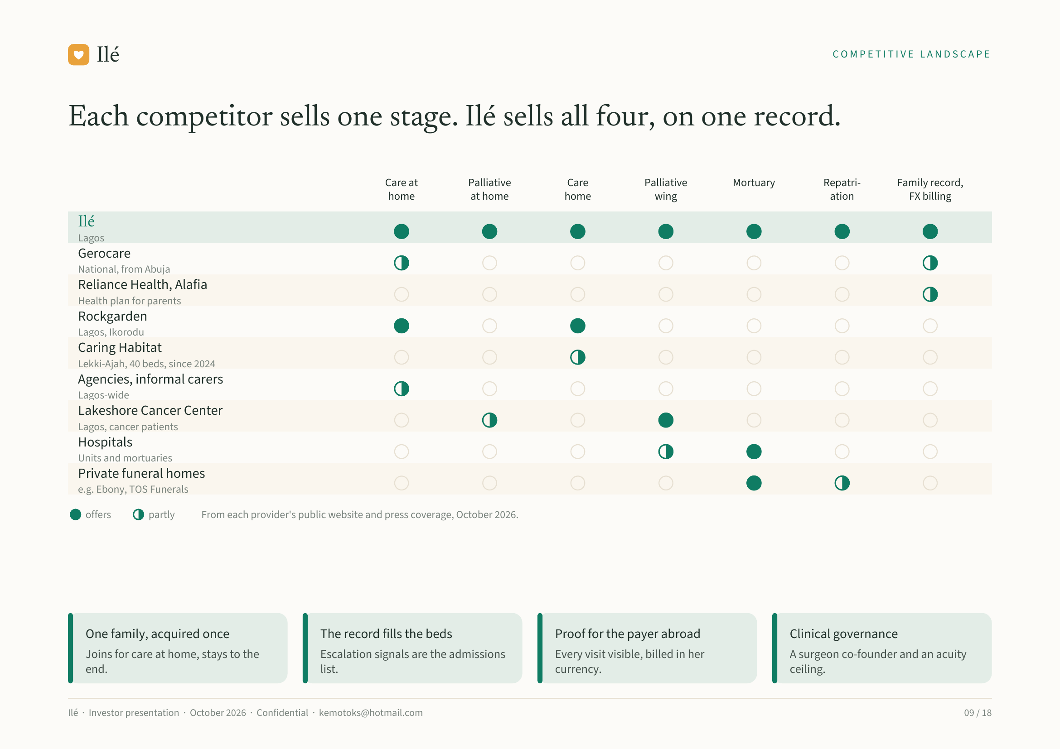
Notes:
Ilé COMPETITIVE LANDSCAPE
Each competitor sells one stage. Ilé sells all four, on one record.
Care at Palliative Care Palliative Mortuary Repatri- Family record,
home at home home wing ation FX billing
Ilé
Lagos
Gerocare
National, from Abuja
Reliance Health, Alafia
Health plan for parents
Rockgarden
Lagos, Ikorodu
Caring Habitat
Lekki-Ajah, 40 beds, since 2024
Agencies, informal carers
Lagos-wide
Lakeshore Cancer Center
Lagos, cancer patients
Hospitals
Units and mortuaries
Private funeral homes
e.g. Ebony, TOS Funerals
offers partly From each provider's public website and press coverage, October 2026.
One family, acquired once The record fills the beds Proof for the payer abroad Clinical governance
Joins for care at home, stays to the Escalation signals are the admissions Every visit visible, billed in her A surgeon co-founder and an acuity
end. list. currency. ceiling.
Ilé · Investor presentation · October 2026 · Confidential · kemotoks@hotmail.com 09 / 18

Slide 10
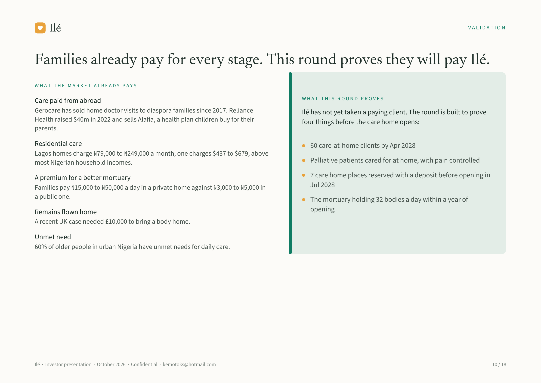
Notes:
Ilé VALIDATION
Families already pay for every stage. This round proves they will pay Ilé.
WHAT THE MARKET ALREADY PAYS
WHAT THIS ROUND PROVES
Care paid from abroad
Gerocare has sold home doctor visits to diaspora families since 2017. Reliance Ilé has not yet taken a paying client. The round is built to prove
Health raised $40m in 2022 and sells Alafia, a health plan children buy for their four things before the care home opens:
parents.
Residential care 60 care-at-home clients by Apr 2028
Lagos homes charge ₦79,000 to ₦249,000 a month; one charges $437 to $679, above
most Nigerian household incomes. Palliative patients cared for at home, with pain controlled
A premium for a better mortuary 7 care home places reserved with a deposit before opening in
Families pay ₦15,000 to ₦50,000 a day in a private home against ₦3,000 to ₦5,000 in Jul 2028
a public one. The mortuary holding 32 bodies a day within a year of
Remains flown home opening
A recent UK case needed £10,000 to bring a body home.
Unmet need
60% of older people in urban Nigeria have unmet needs for daily care.
Ilé · Investor presentation · October 2026 · Confidential · kemotoks@hotmail.com 10 / 18

Slide 11
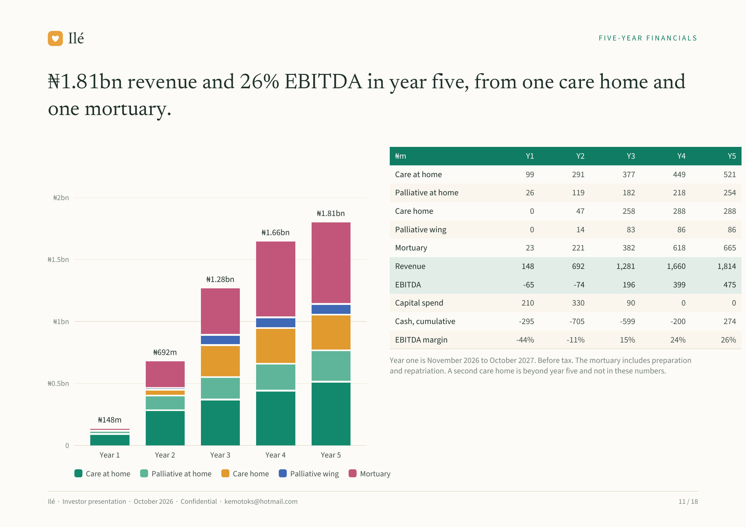
Notes:
Ilé FIVE-YEAR FINANCIALS
₦1.81bn revenue and 26% EBITDA in year five, from one care home and
one mortuary.
₦m Y1 Y2 Y3 Y4 Y5
Care at home 99 291 377 449 521
Palliative at home 26 119 182 218 254
₦2bn
₦1.81bn Care home 0 47 258 288 288
₦1.66bn Palliative wing 0 14 83 86 86
Mortuary 23 221 382 618 665
₦1.5bn
Revenue 148 692 1,281 1,660 1,814
₦1.28bn
EBITDA -65 -74 196 399 475
Capital spend 210 330 90 0 0
₦1bn Cash, cumulative -295 -705 -599 -200 274
EBITDA margin -44% -11% 15% 24% 26%
₦692m
Year one is November 2026 to October 2027. Before tax. The mortuary includes preparation
and repatriation. A second care home is beyond year five and not in these numbers.
₦0.5bn
₦148m
0
Year 1 Year 2 Year 3 Year 4 Year 5
Care at home Palliative at home Care home Palliative wing Mortuary
Ilé · Investor presentation · October 2026 · Confidential · kemotoks@hotmail.com 11 / 18

Slide 12
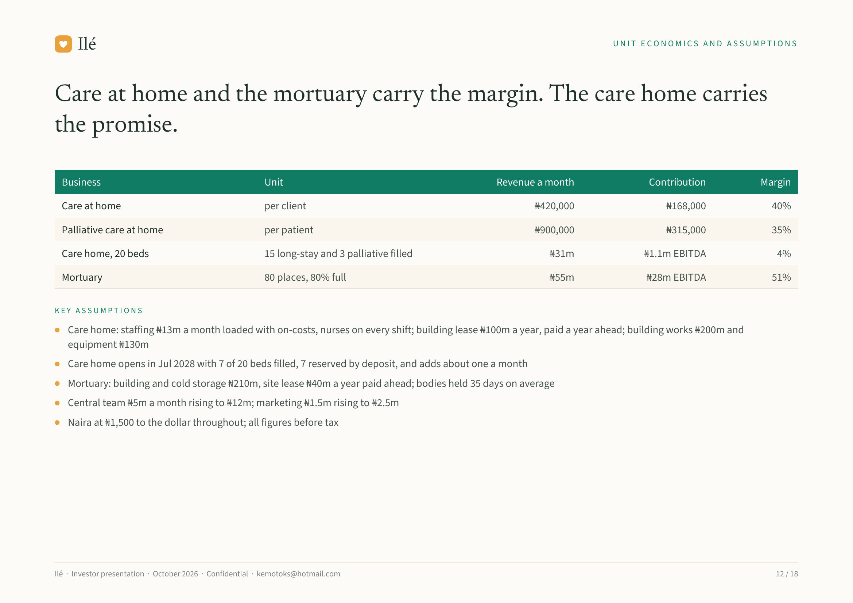
Notes:
Ilé UNIT ECONOMICS AND ASSUMPTIONS
Care at home and the mortuary carry the margin. The care home carries
the promise.
Business Unit Revenue a month Contribution Margin
Care at home per client ₦420,000 ₦168,000 40%
Palliative care at home per patient ₦900,000 ₦315,000 35%
Care home, 20 beds 15 long-stay and 3 palliative filled ₦31m ₦1.1m EBITDA 4%
Mortuary 80 places, 80% full ₦55m ₦28m EBITDA 51%
KEY ASSUMPTIONS
Care home: staffing ₦13m a month loaded with on-costs, nurses on every shift; building lease ₦100m a year, paid a year ahead; building works ₦200m and
equipment ₦130m
Care home opens in Jul 2028 with 7 of 20 beds filled, 7 reserved by deposit, and adds about one a month
Mortuary: building and cold storage ₦210m, site lease ₦40m a year paid ahead; bodies held 35 days on average
Central team ₦5m a month rising to ₦12m; marketing ₦1.5m rising to ₦2.5m
Naira at ₦1,500 to the dollar throughout; all figures before tax
Ilé · Investor presentation · October 2026 · Confidential · kemotoks@hotmail.com 12 / 18

Slide 13
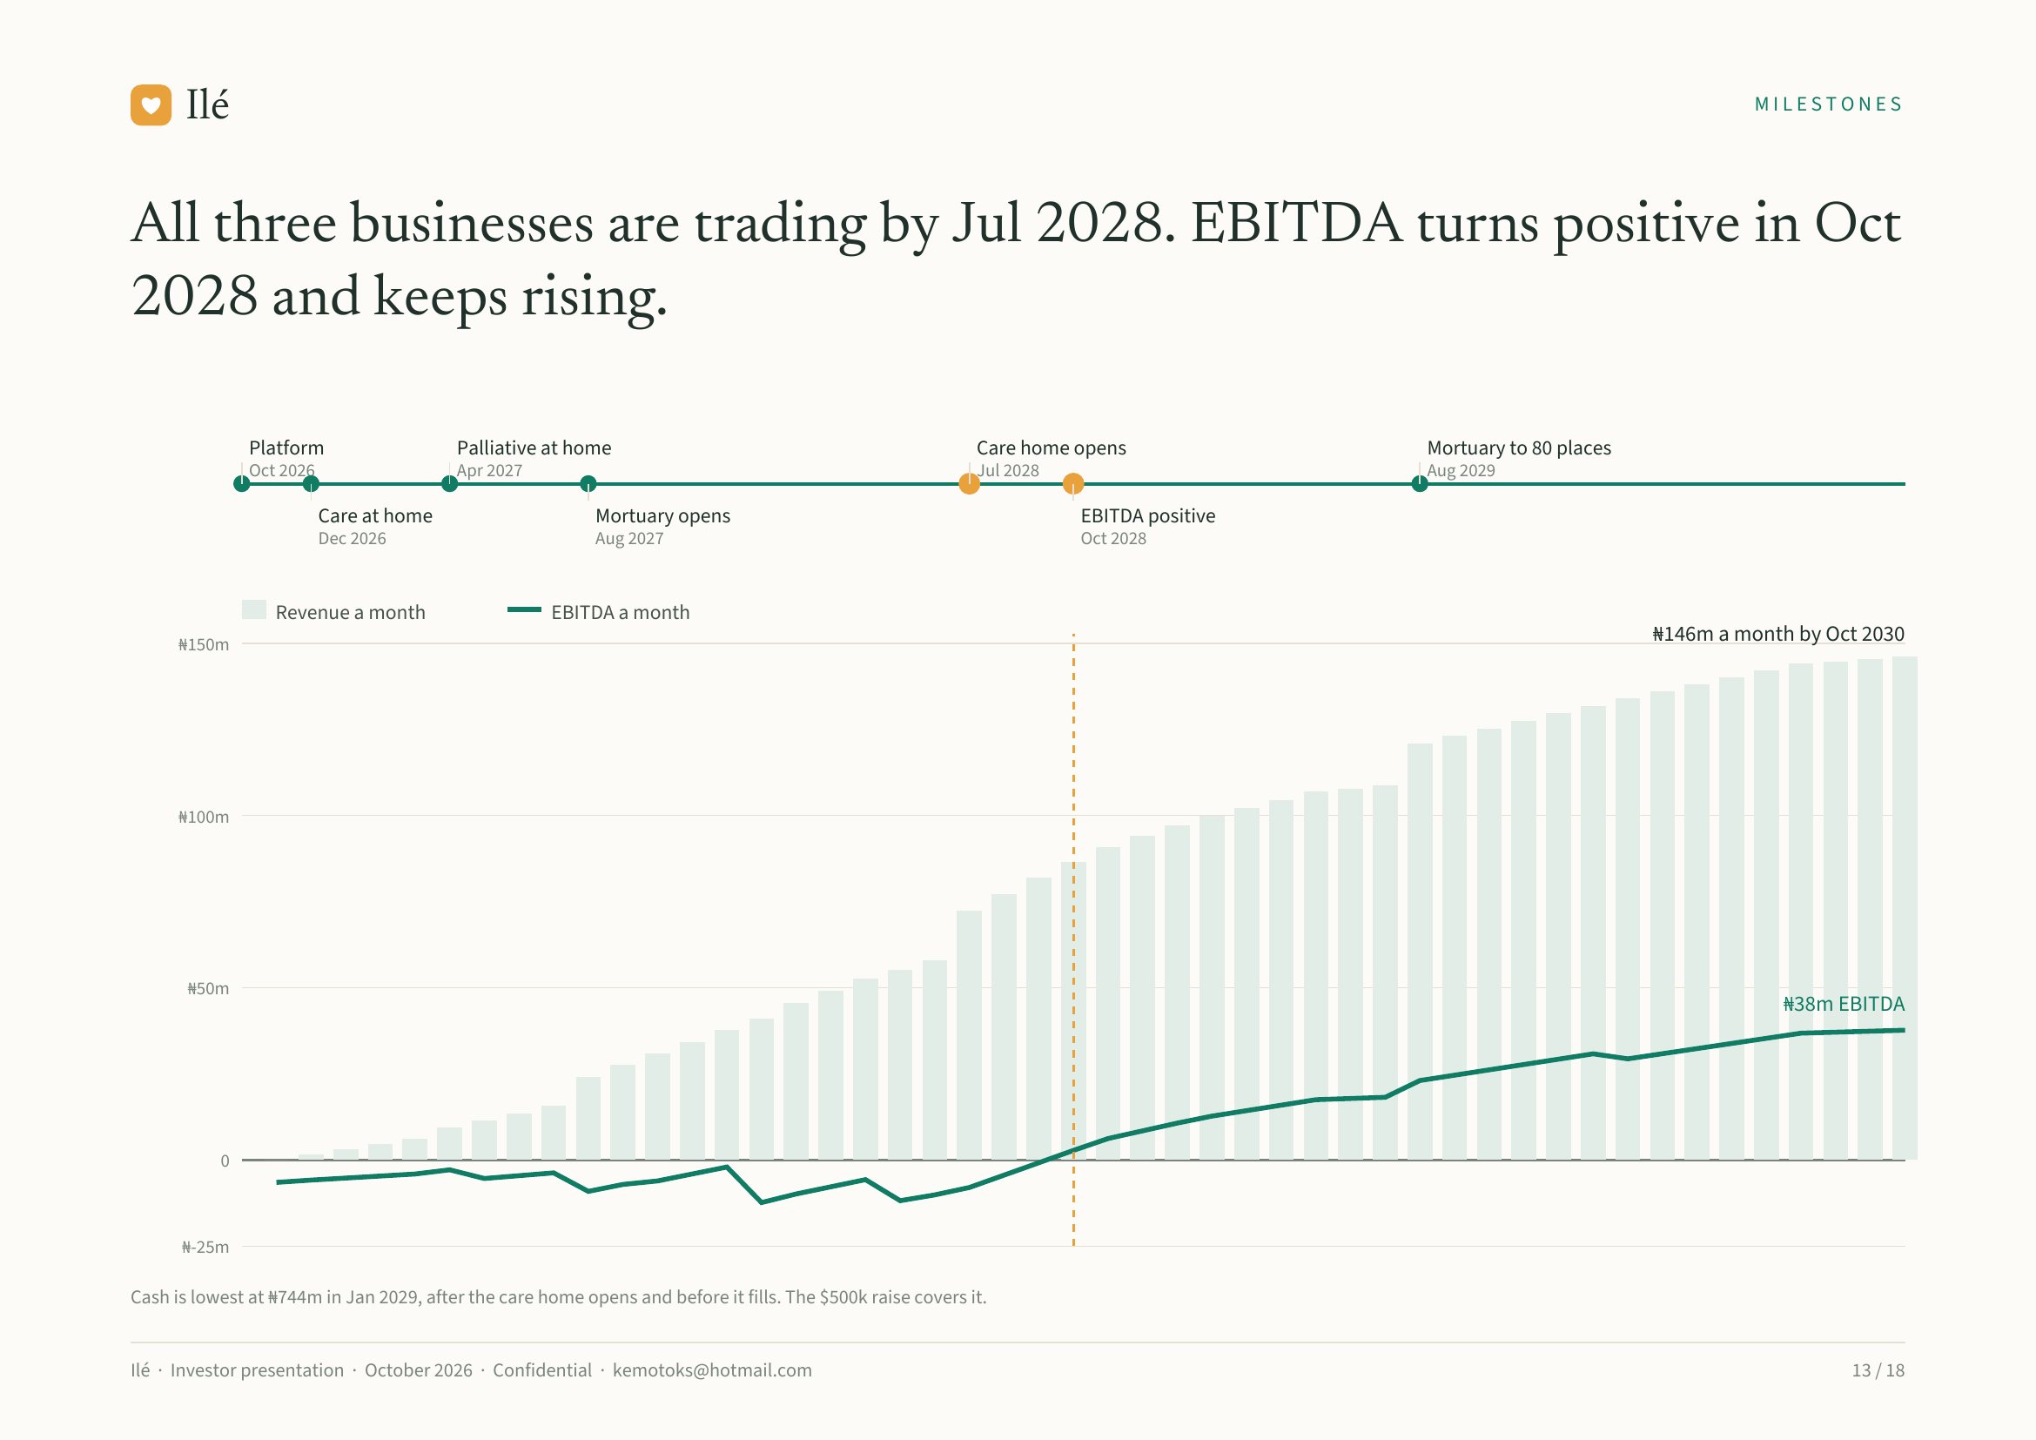
Notes:
Ilé MILESTONES
All three businesses are trading by Jul 2028. EBITDA turns positive in Oct
2028 and keeps rising.
Platform Palliative at home Care home opens Mortuary to 80 places
Oct 2026 Apr 2027 Jul 2028 Aug 2029
Care at home Mortuary opens EBITDA positive
Dec 2026 Aug 2027 Oct 2028
Revenue a month EBITDA a month
₦150m ₦146m a month by Oct 2030
₦100m
₦50m
₦38m EBITDA
0
₦-25m
Cash is lowest at ₦744m in Jan 2029, after the care home opens and before it fills. The $500k raise covers it.
Ilé · Investor presentation · October 2026 · Confidential · kemotoks@hotmail.com 13 / 18

Slide 14
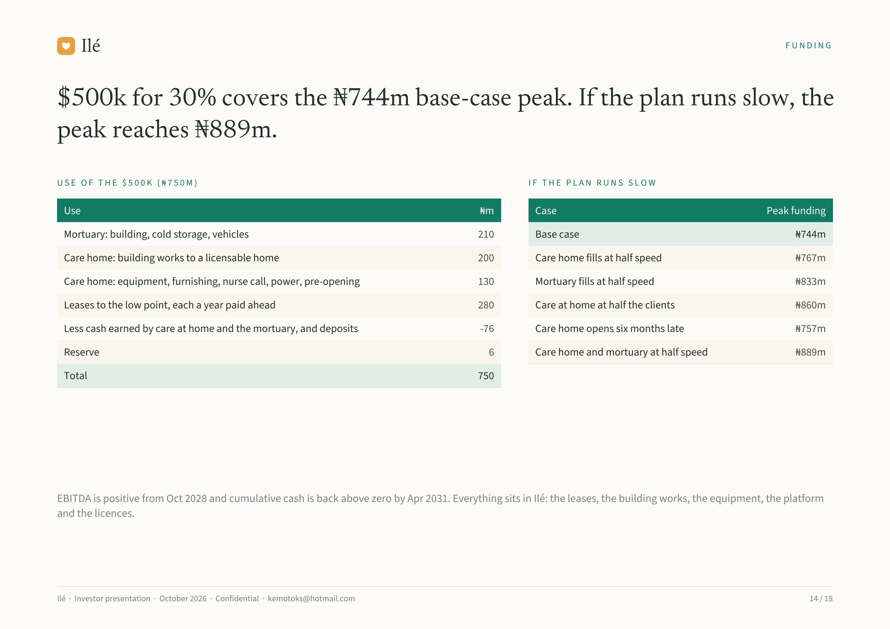
Notes:
Ilé FUNDING
$500k for 30% covers the ₦744m base-case peak. If the plan runs slow, the
peak reaches ₦889m.
USE OF THE $500K (₦750M) IF THE PLAN RUNS SLOW
Use ₦m Case Peak funding
Mortuary: building, cold storage, vehicles 210 Base case ₦744m
Care home: building works to a licensable home 200 Care home fills at half speed ₦767m
Care home: equipment, furnishing, nurse call, power, pre-opening 130 Mortuary fills at half speed ₦833m
Leases to the low point, each a year paid ahead 280 Care at home at half the clients ₦860m
Less cash earned by care at home and the mortuary, and deposits -76 Care home opens six months late ₦757m
Reserve 6 Care home and mortuary at half speed ₦889m
Total 750
EBITDA is positive from Oct 2028 and cumulative cash is back above zero by Apr 2031. Everything sits in Ilé: the leases, the building works, the equipment, the platform
and the licences.
Ilé · Investor presentation · October 2026 · Confidential · kemotoks@hotmail.com 14 / 18

Slide 15
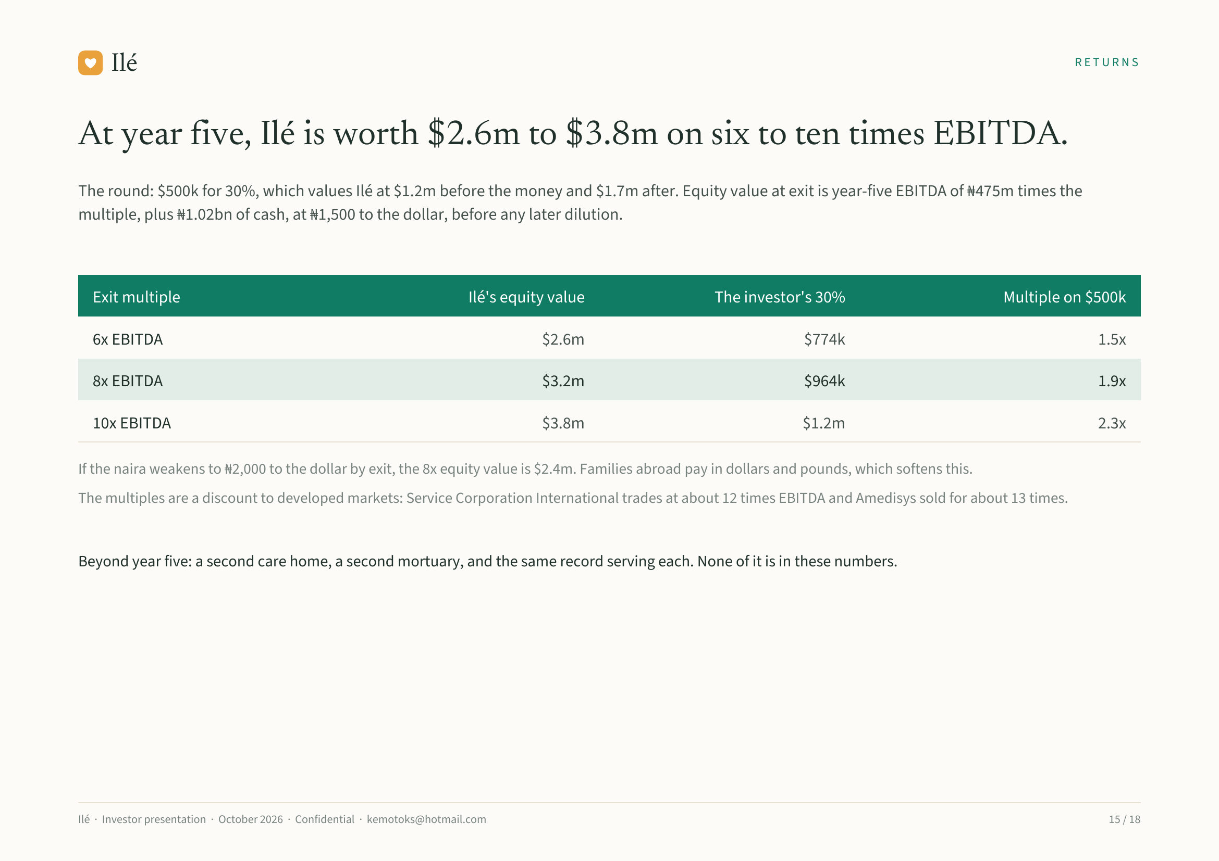
Notes:
Ilé RETURNS
At year five, Ilé is worth $2.6m to $3.8m on six to ten times EBITDA.
The round: $500k for 30%, which values Ilé at $1.2m before the money and $1.7m after. Equity value at exit is year-five EBITDA of ₦475m times the
multiple, plus ₦1.02bn of cash, at ₦1,500 to the dollar, before any later dilution.
Exit multiple Ilé's equity value The investor's 30% Multiple on $500k
6x EBITDA $2.6m $774k 1.5x
8x EBITDA $3.2m $964k 1.9x
10x EBITDA $3.8m $1.2m 2.3x
If the naira weakens to ₦2,000 to the dollar by exit, the 8x equity value is $2.4m. Families abroad pay in dollars and pounds, which softens this.
The multiples are a discount to developed markets: Service Corporation International trades at about 12 times EBITDA and Amedisys sold for about 13 times.
Beyond year five: a second care home, a second mortuary, and the same record serving each. None of it is in these numbers.
Ilé · Investor presentation · October 2026 · Confidential · kemotoks@hotmail.com 15 / 18

Slide 16
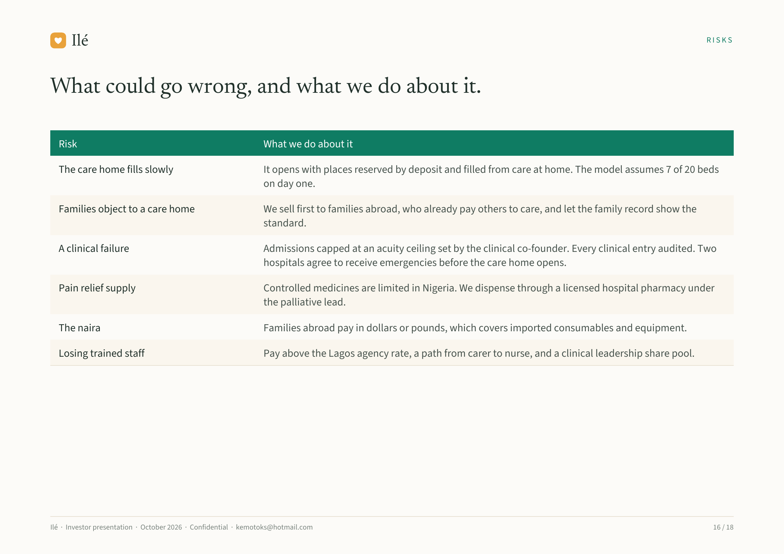
Notes:
Ilé RISKS
What could go wrong, and what we do about it.
Risk What we do about it
The care home fills slowly It opens with places reserved by deposit and filled from care at home. The model assumes 7 of 20 beds
on day one.
Families object to a care home We sell first to families abroad, who already pay others to care, and let the family record show the
standard.
A clinical failure Admissions capped at an acuity ceiling set by the clinical co-founder. Every clinical entry audited. Two
hospitals agree to receive emergencies before the care home opens.
Pain relief supply Controlled medicines are limited in Nigeria. We dispense through a licensed hospital pharmacy under
the palliative lead.
The naira Families abroad pay in dollars or pounds, which covers imported consumables and equipment.
Losing trained staff Pay above the Lagos agency rate, a path from carer to nurse, and a clinical leadership share pool.
Ilé · Investor presentation · October 2026 · Confidential · kemotoks@hotmail.com 16 / 18

Slide 17
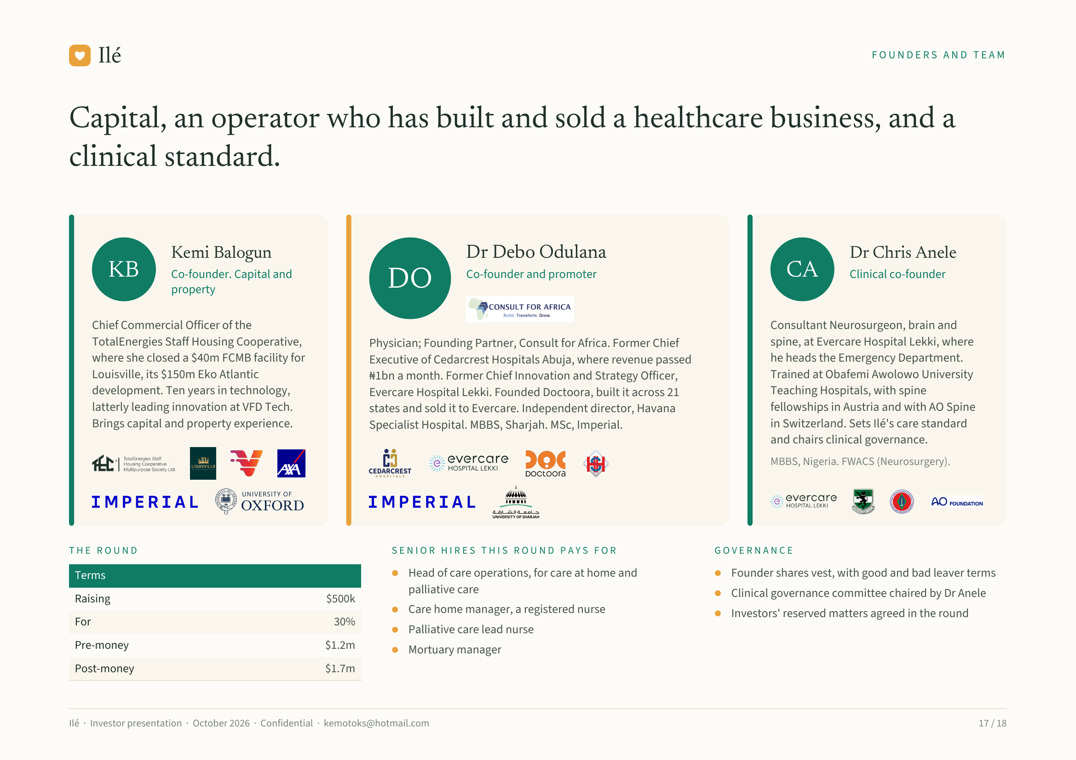
Notes:
Ilé FOUNDERS AND TEAM
Capital, an operator who has built and sold a healthcare business, and a
clinical standard.
Kemi Balogun Dr Debo Odulana Dr Chris Anele
KB Co-founder. Capital and
DO Co-founder and promoter CA Clinical co-founder
property
Chief Commercial Officer of the Consultant Neurosurgeon, brain and
TotalEnergies Staff Housing Cooperative, Physician; Founding Partner, Consult for Africa. Former Chief spine, at Evercare Hospital Lekki, where
where she closed a $40m FCMB facility for Executive of Cedarcrest Hospitals Abuja, where revenue passed he heads the Emergency Department.
Louisville, its $150m Eko Atlantic ₦1bn a month. Former Chief Innovation and Strategy Officer, Trained at Obafemi Awolowo University
development. Ten years in technology, Evercare Hospital Lekki. Founded Doctoora, built it across 21 Teaching Hospitals, with spine
latterly leading innovation at VFD Tech. states and sold it to Evercare. Independent director, Havana fellowships in Austria and with AO Spine
Brings capital and property experience. Specialist Hospital. MBBS, Sharjah. MSc, Imperial. in Switzerland. Sets Ilé's care standard
and chairs clinical governance.
MBBS, Nigeria. FWACS (Neurosurgery).
THE ROUND SENIOR HIRES THIS ROUND PAYS FOR GOVERNANCE
Terms Head of care operations, for care at home and Founder shares vest, with good and bad leaver terms
palliative care Clinical governance committee chaired by Dr Anele
Raising $500k
Care home manager, a registered nurse Investors' reserved matters agreed in the round
For 30%
Palliative care lead nurse
Pre-money $1.2m Mortuary manager
Post-money $1.7m
Ilé · Investor presentation · October 2026 · Confidential · kemotoks@hotmail.com 17 / 18

Slide 18
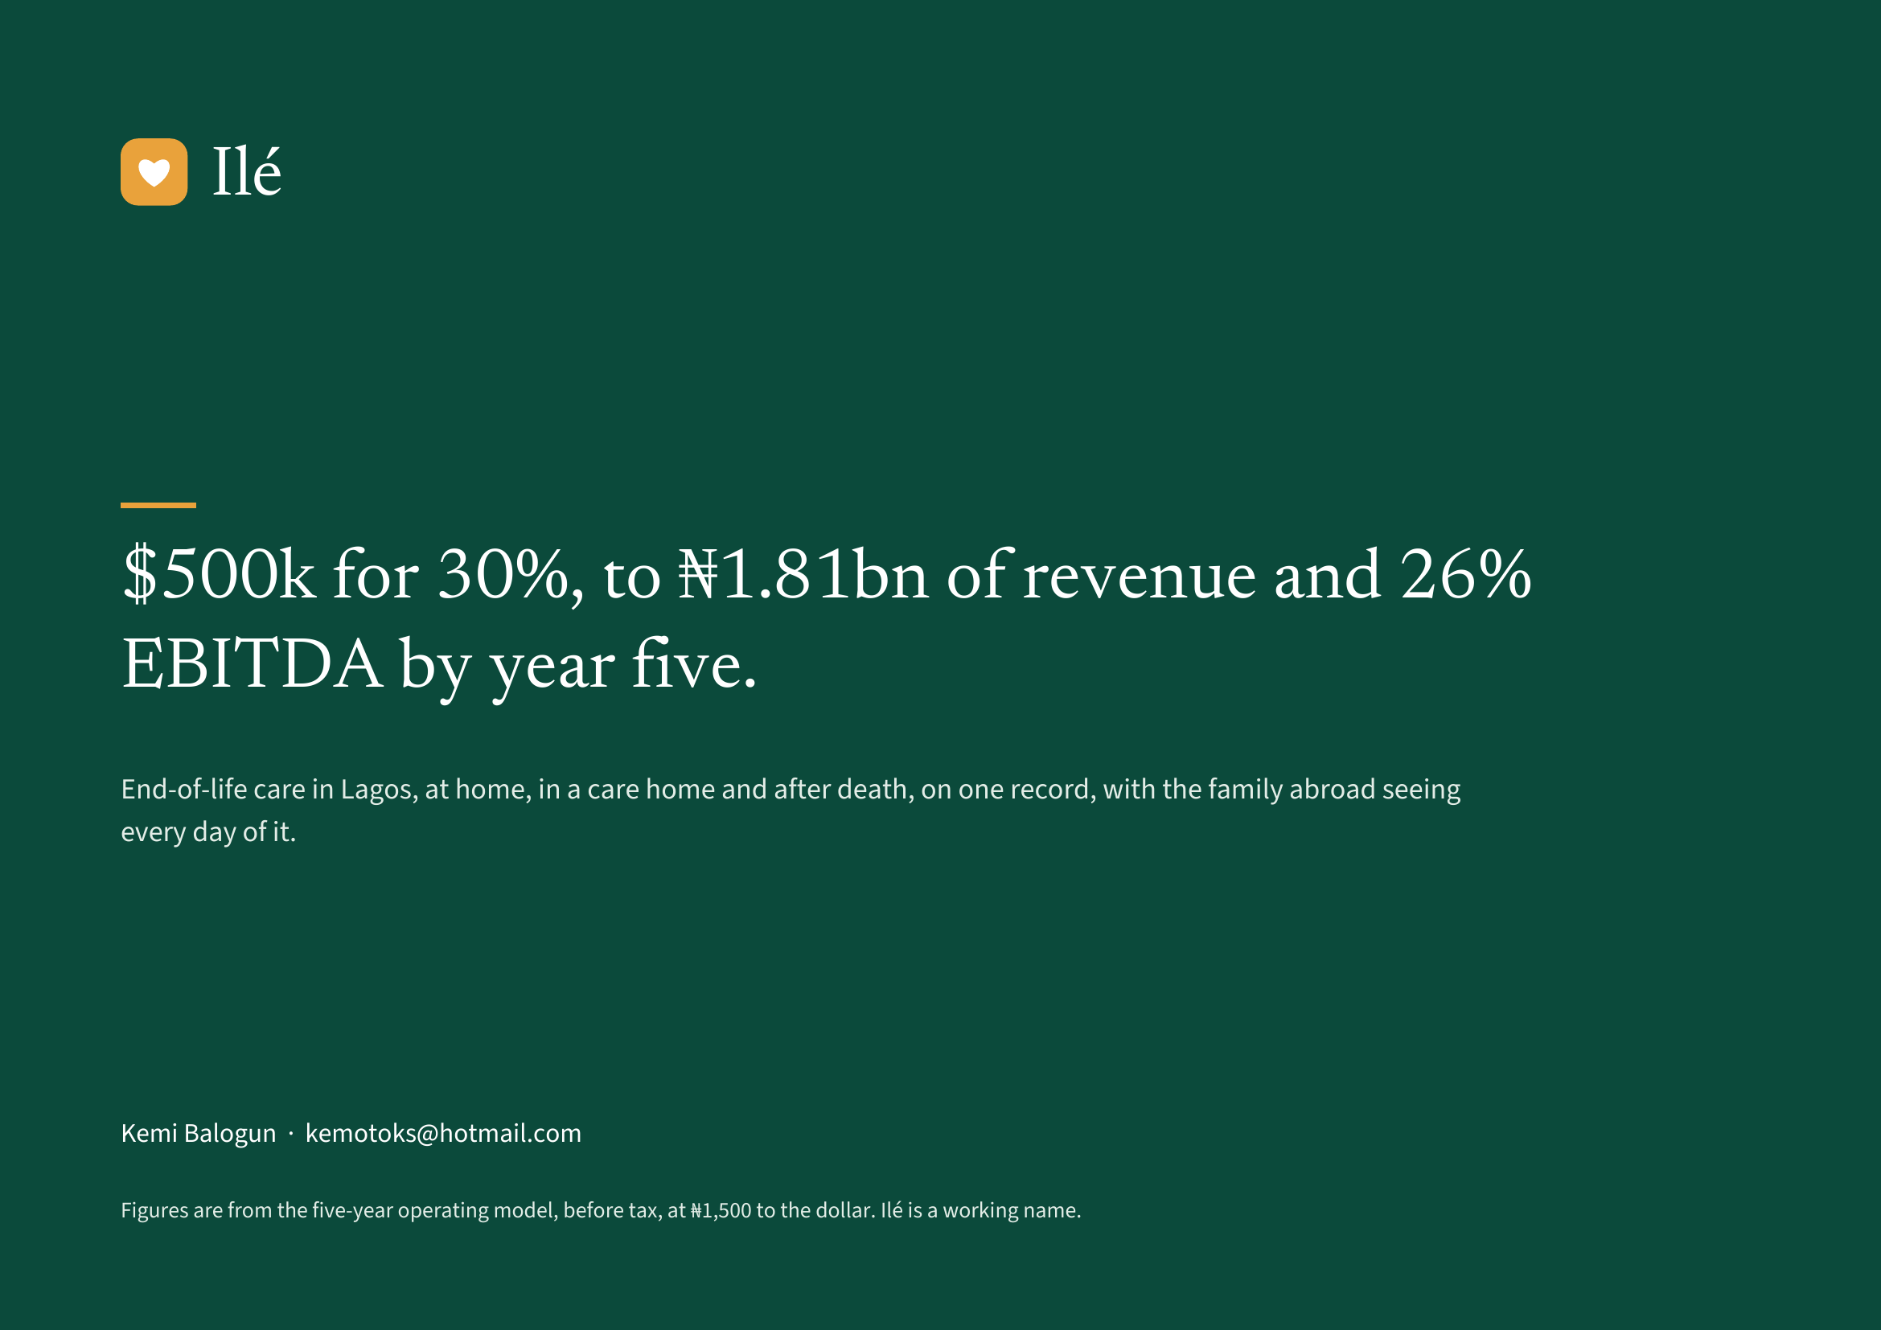
Notes:
Ilé
$500k for 30%, to ₦1.81bn of revenue and 26%
EBITDA by year five.
End-of-life care in Lagos, at home, in a care home and after death, on one record, with the family abroad seeing
every day of it.
Kemi Balogun · kemotoks@hotmail.com
Figures are from the five-year operating model, before tax, at ₦1,500 to the dollar. Ilé is a working name.

